Slide 1
RPG Proof Of Concept
Giuseppe Scoppino

Slide 2
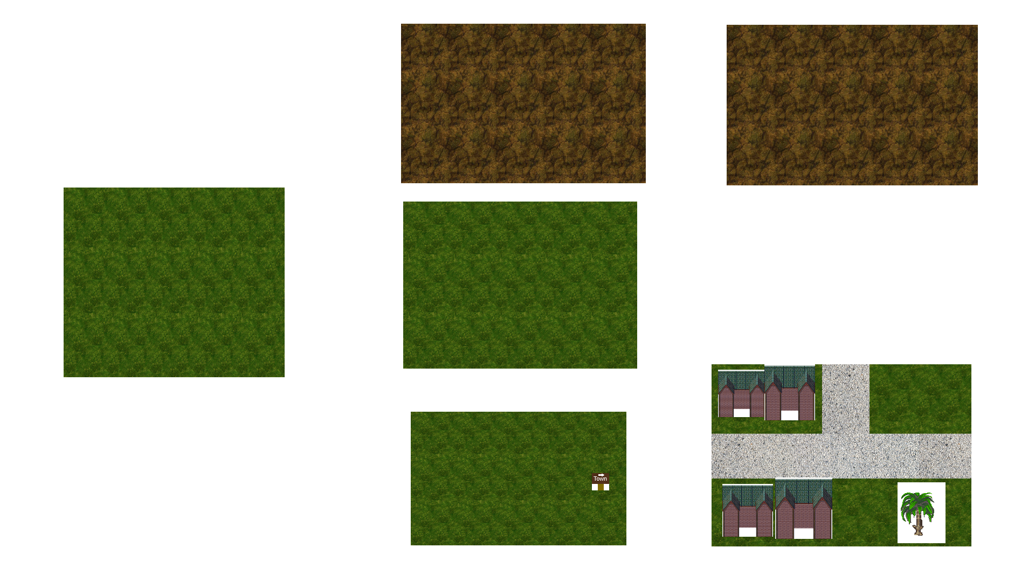
Game Map

Slide 3
Game Concept
2D, “bird’s eye”, RPG
Go on an adventure, meeting new people, finding items, and fighting enemies.
Find the boss (hint: not implemented yet)

Slide 4
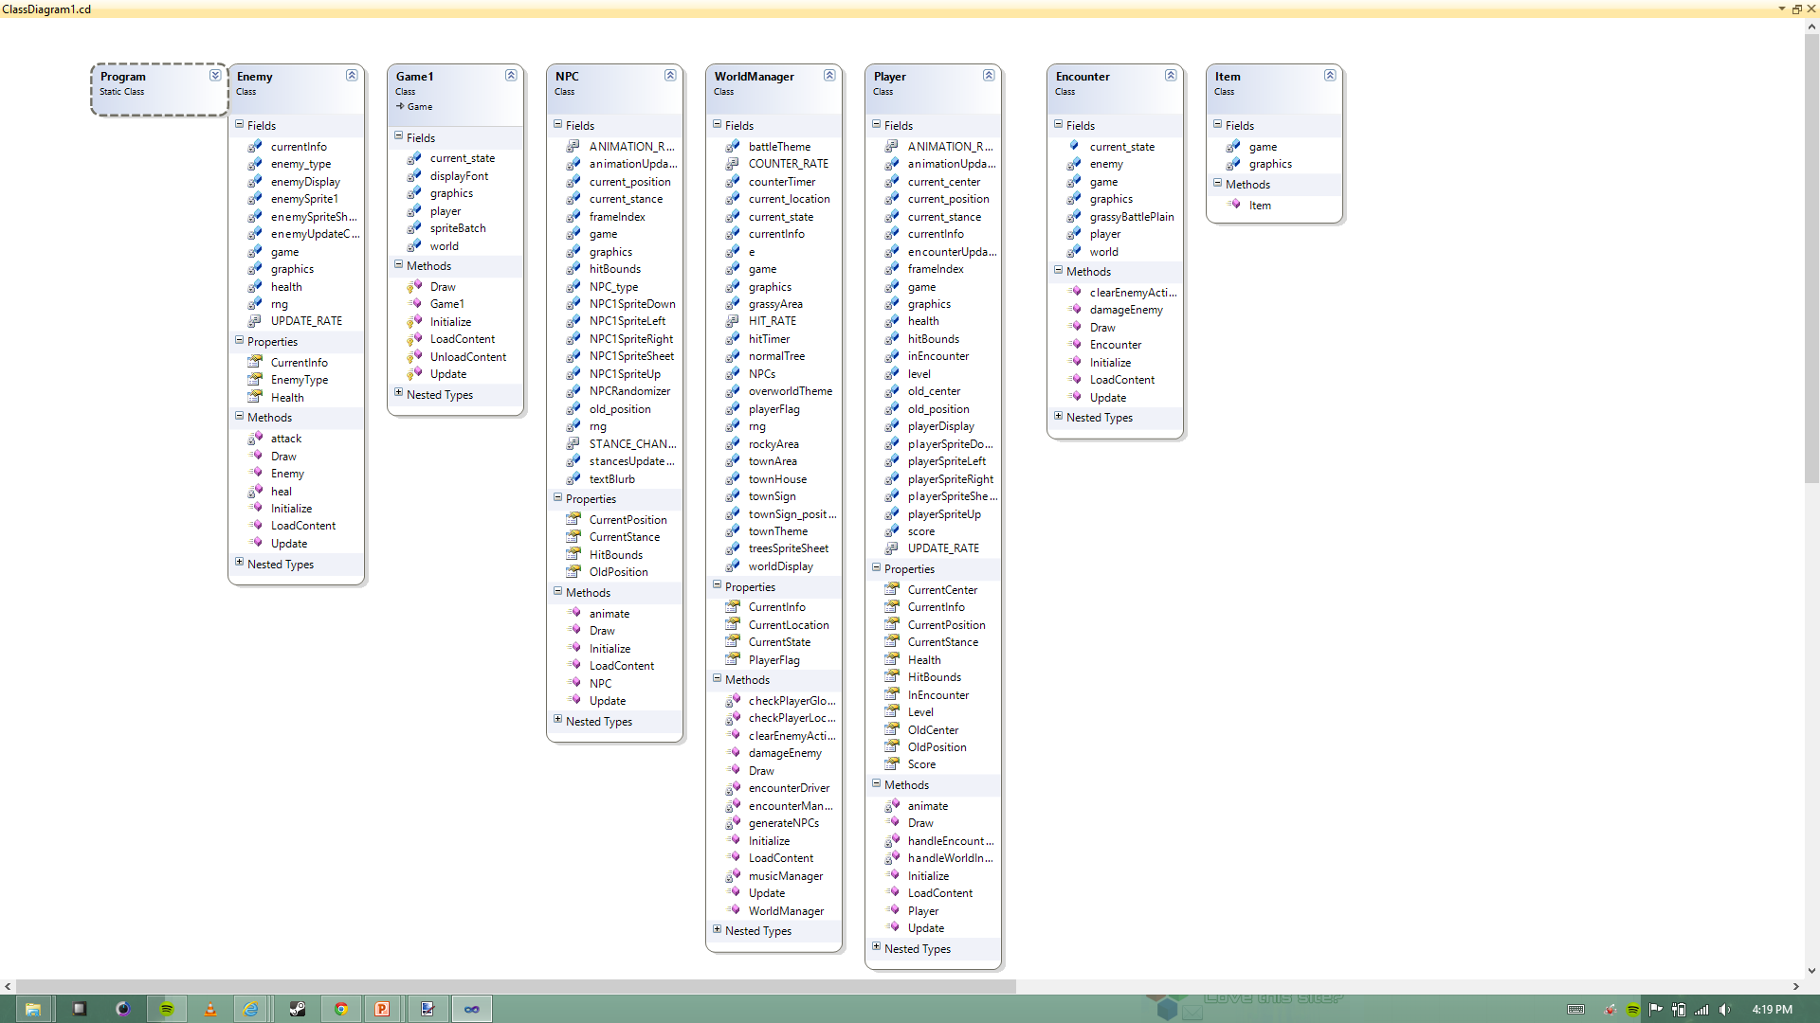
UML Class Diagram

Slide 5
Game Logic
Game1 creates three main entities to run the game; a World Manager, a Player, and a state variable which can be either RUNNING or PAUSED.
WorldManager is the main body of the game; it manages all location draw routines, NPC behavior, collision detection, music playback, and makes calls to an Encounter class for random enemy encounters
The Encounter class takes a parameter of type Enemy and this determines what type of enemy the battle uses. A flag handles the switching between Player actions in the Player update() method and the psuedo-random actions of the generated enemy.
The NPC and Enemy classes are basic shell classes which do little in the terms of actual algorithms.
The Player class handles all the user input other than pause screen input and translates them to in game actions. As much of the player and human interaction is kept in the Player class as possible, though some player variables have to be kept outside for compatibility purposes
Data is passed between classes and modified through instance parameters. Access to elements in the program are generally extremely high-level, considering the nature of the game requires many different classes to share data on a regular basis.

Slide 6
Sources (All content to the best knowledge of my knowledge is free under General Commons License)
http://users.telenet.be/freakytweaker/gamedev/resources/img/sprites/forest/TreeSprites2.gif
http://static9.depositphotos.com/1003840/1081/i/950/depositphotos_10811232-Slate-stone-texture.jpg
http://i218.photobucket.com/albums/cc308/kylock1/6Actor_5.png
http://fc03.deviantart.net/fs71/f/2011/130/a/e/grassy_plain_by_gkid2000-d3g1zsn.jpg
http://freemusicarchive.org/
http://www.36peas.com/blog/tag/creativecommons
http://www.36peas.com/blog/tag/sprite
http://thundernoodle.net/notblog/2011/10/17/how-to-animate-a-sprite-using-a-sprite-sheet-in-xna/
http://userpages.umbc.edu/~sohisa1/spring2012vers/games/cryoPyro.html
http://www.mayang.com/textures/
http://www.rpgmakervx.net/lofiversion/index.php/t42535.html
http://spriters-resource.com/
http://gamedev.stackexchange.com/questions/7069/2d-graphics-why-use-spritesheets
http://www.opengameart.org

